Slide 1
Why Use Mass Spectrometry to Measure Proteins?
Problems with clinical immunoassays
Single-plex
Poor standardization
Hook effect
Autoantibodies
Hoofnagle and Wener, J Immunol Methods (2009)

Slide 2
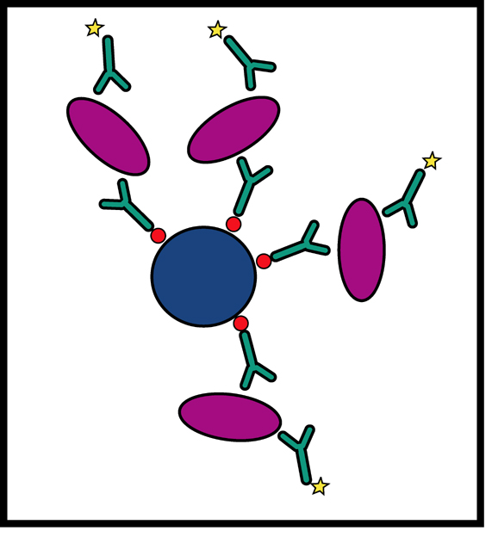
Traditional Automated Immunoassays
Capture antibody selects sandwiches detected by enzyme-conjugated secondary Generally, one at a time

Slide 3
Can We Multiplex Immunoassays?
Y
Y
Y
Y
Y
Y
vs.

Slide 4
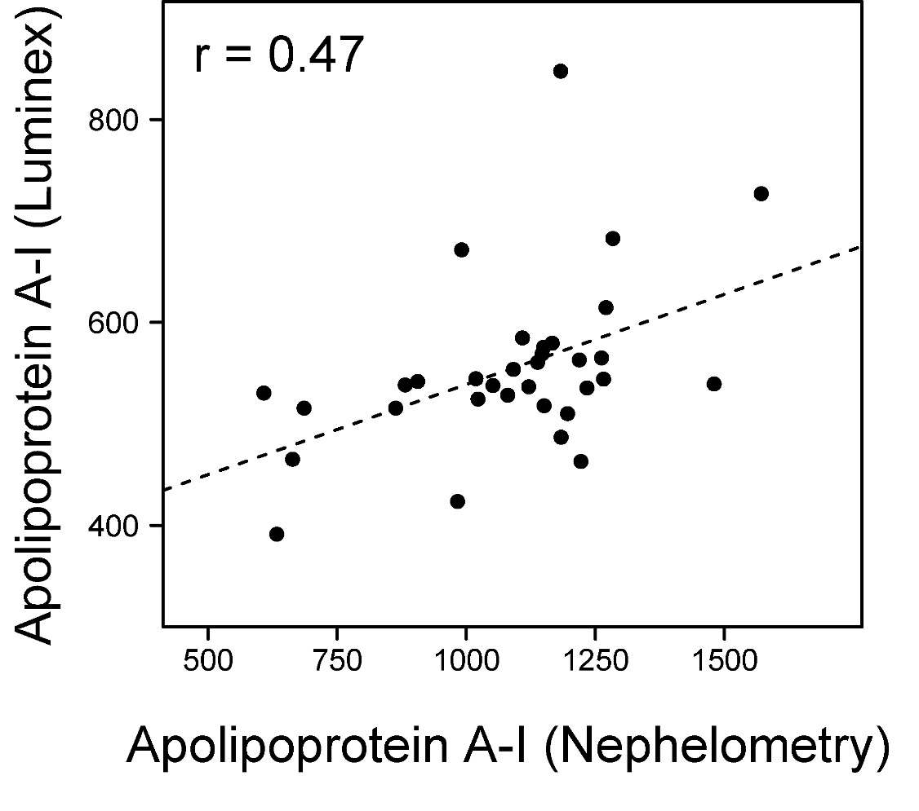
Can We Multiplex Immunoassays?
Not easily.

Slide 5
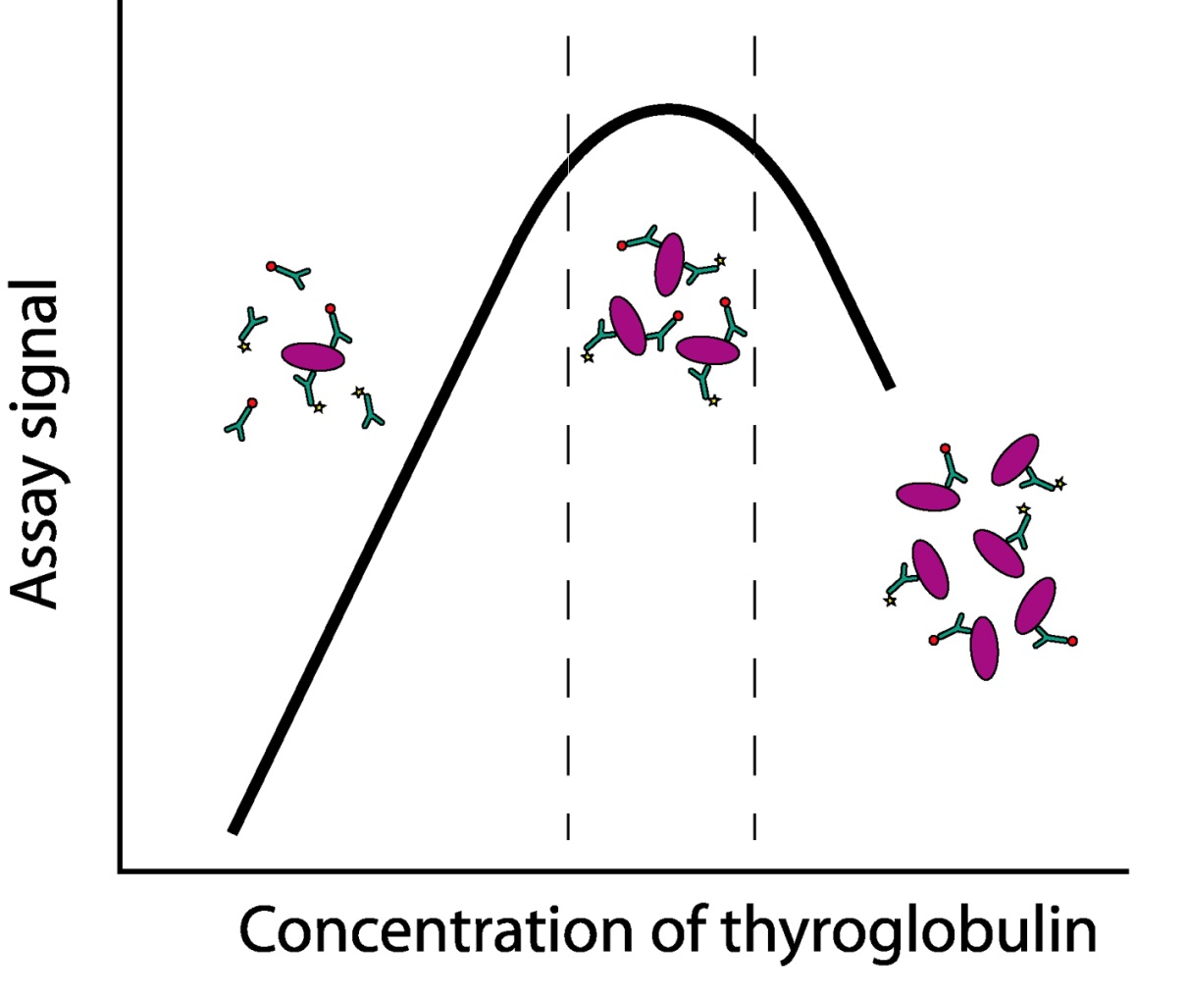
Hook Effect
Too much tumor antigen can lead to negative result

Slide 6
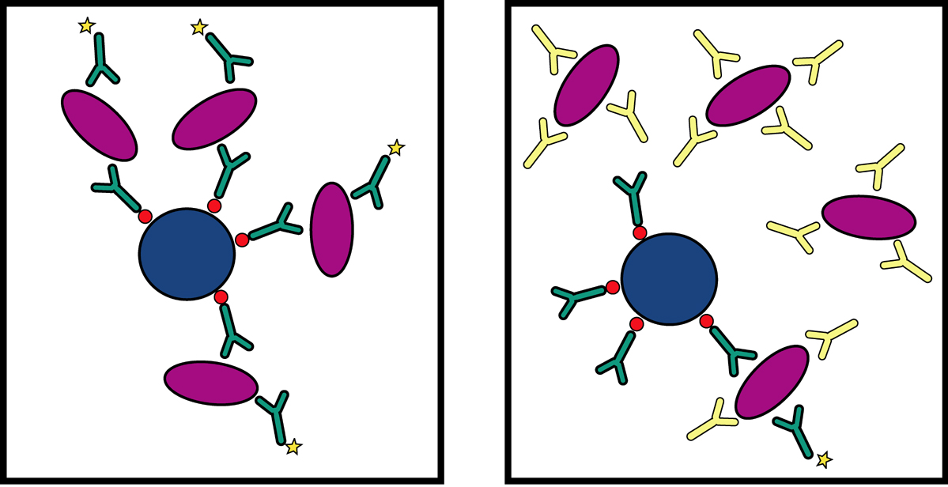
Autoantibody Interference
Autoantibodies can sequester antigen away from detectable complexes
Falsely negative results with sandwich assays

Slide 7
Mass Spectrometry: A Potential Solution
Direct detection of analyte by mass spectrometry
Interlaboratory calibration
Improved specificity
No sandwiches formed
No hook effect
Saturation of signal – plateau of calibration curve
Digestion of all proteins
Destroy autoantibodies

Slide 8
Discovery Proteomics: Is it suitable to replace immunoassays?

Slide 9
Shotgun Proteomics
Protein Mixture
MS/MS
1
2
3
3
proteolysis
2
µLC
MS
1
Peptide Mixture

Slide 10
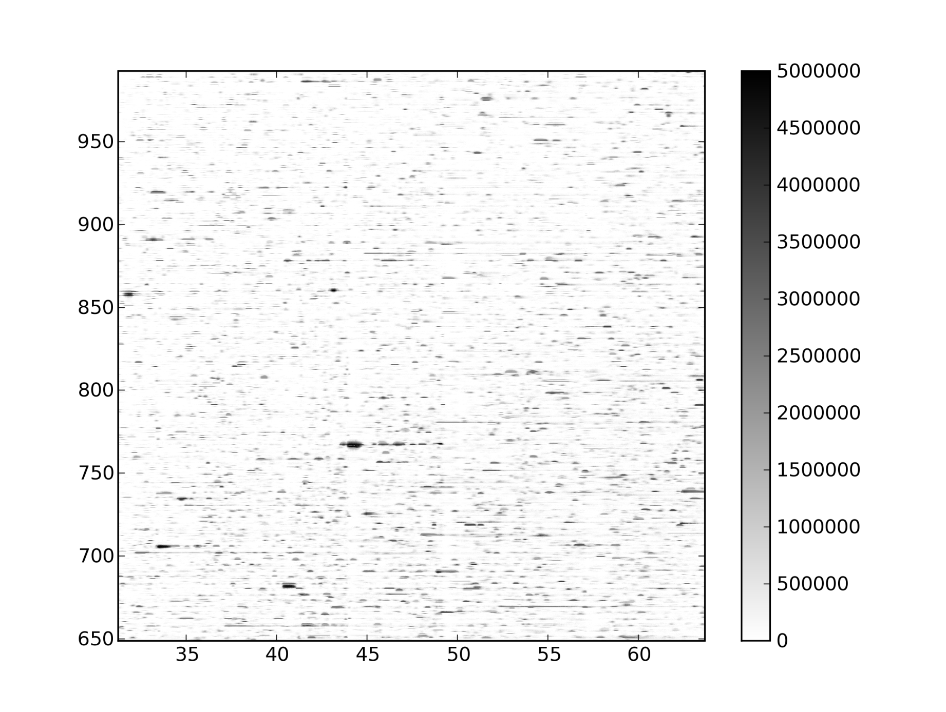
These Mixtures are Complicated!
MS Scan
MS/MS
MS/MS
MS/MS
m/z
Time (Min)

Slide 11

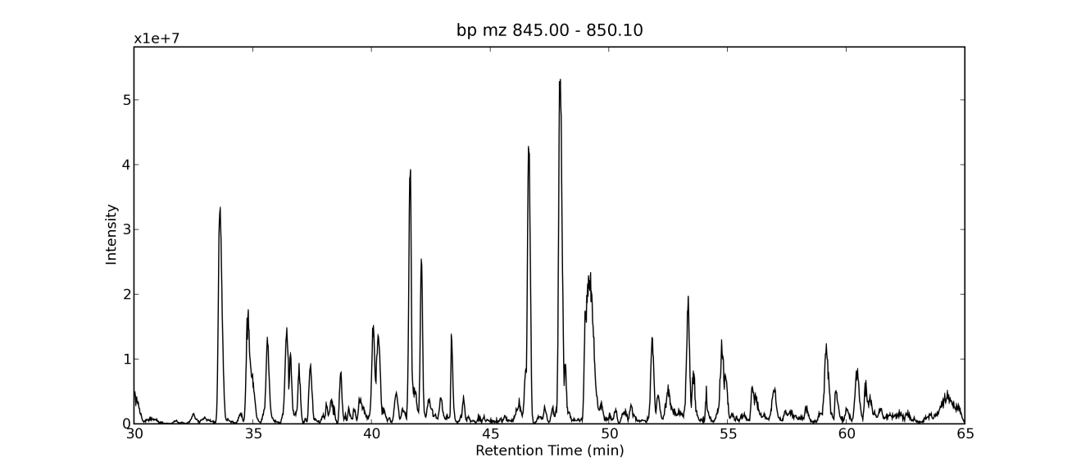
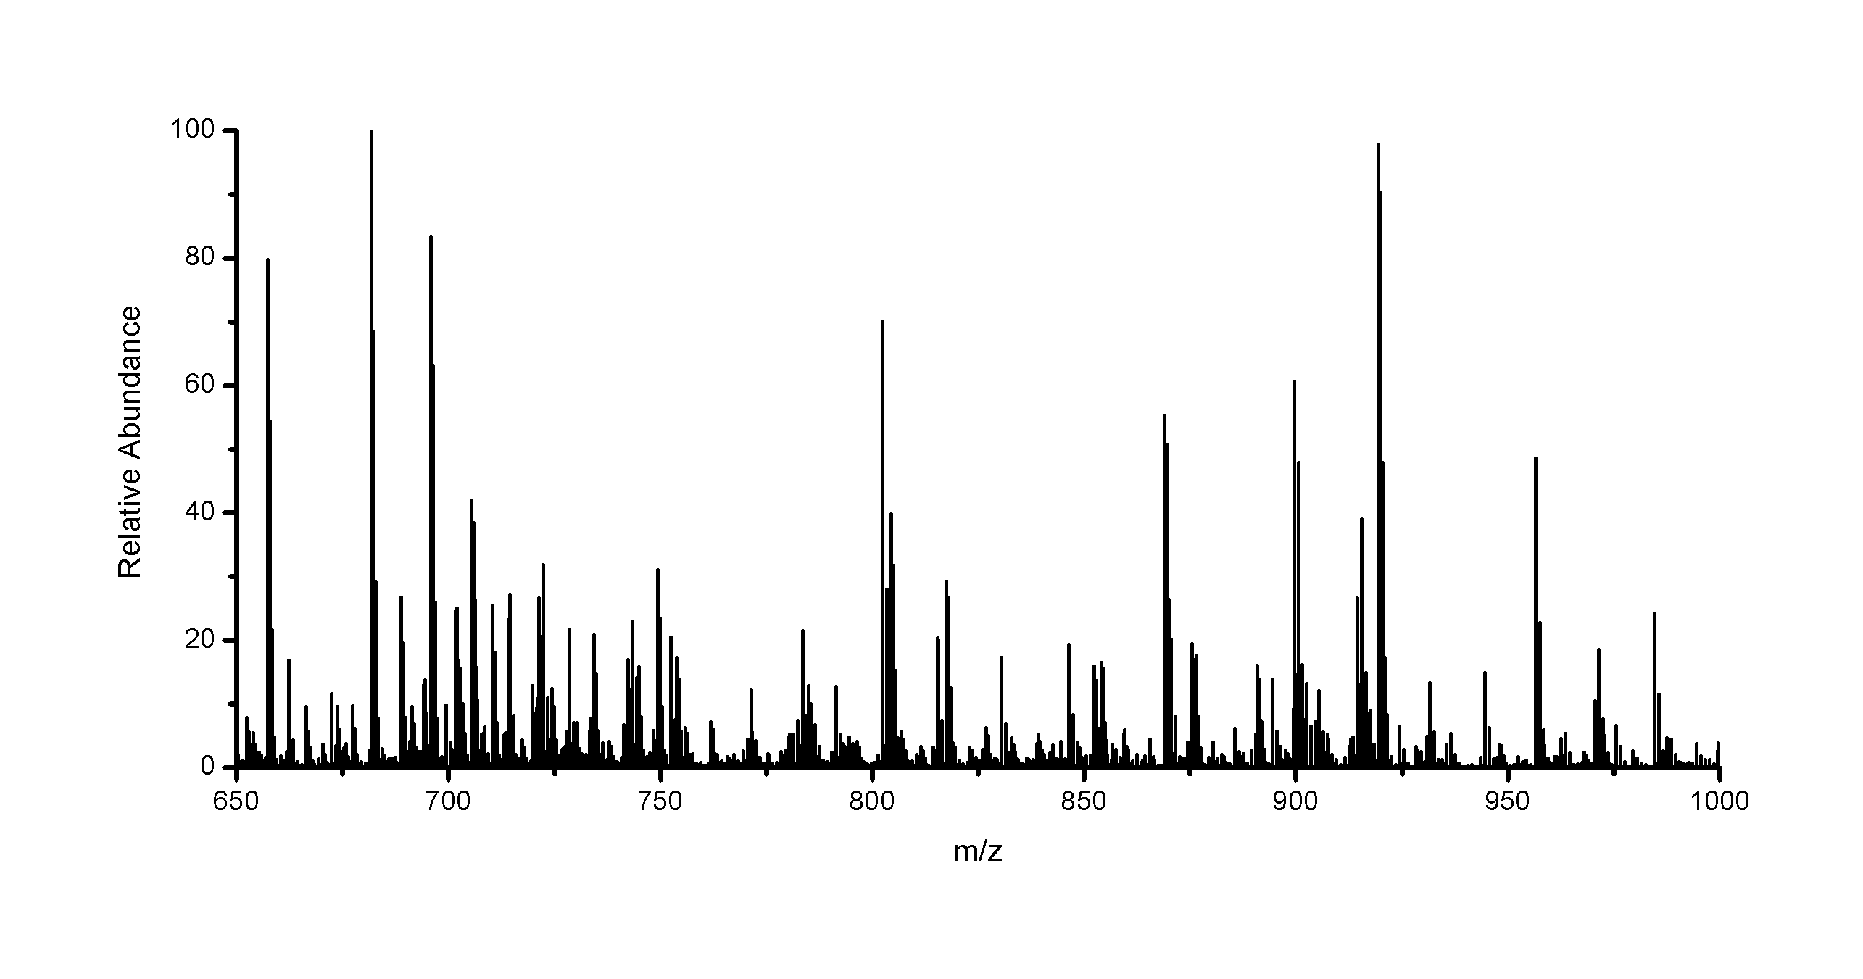
These Mixtures are Complicated!
m/z
Time (Min)

Slide 12
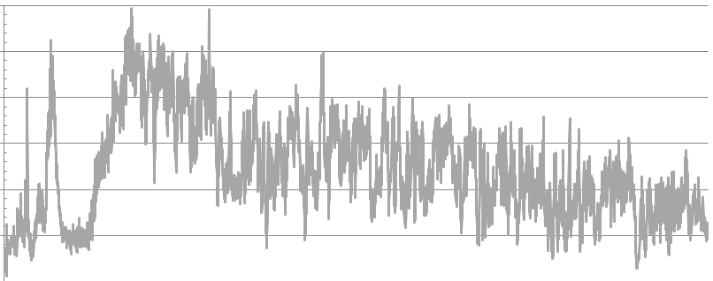
Sampling Every Precursor Using DDA
Number of precursors from m/z 400 to 1,000
300
250
200
Number of precursors
Average:
120.58
150
100
50
0
Scan index
To get every precursor using DDA, we would have to collect 121 MS/MS spectra on average per chromatographic peak
Notes:
We count the number of precursor in each scan

Slide 13
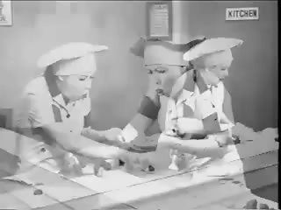
Data Dependent Acquisition will Always Under Sample

Slide 14
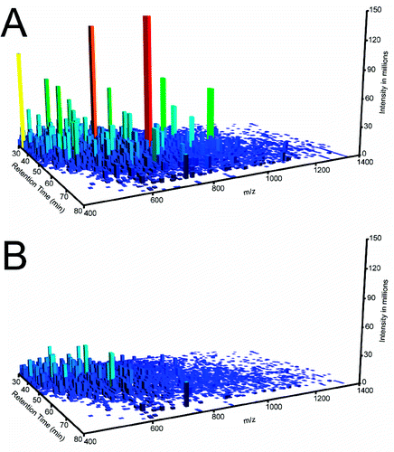
DDA always misses and is least reproducible on the low abundant signals
Hoopmann et al, JPR 2009

Slide 15
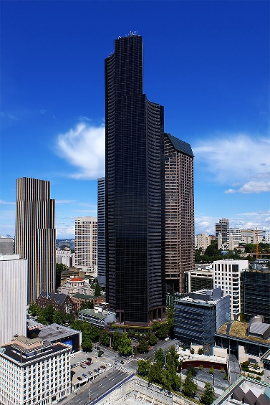
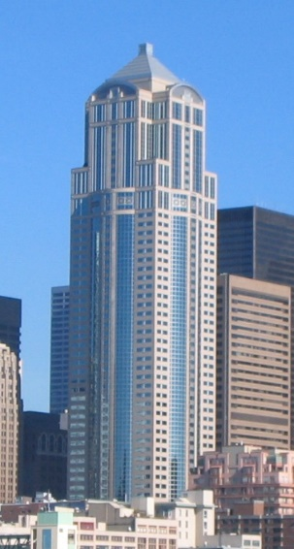
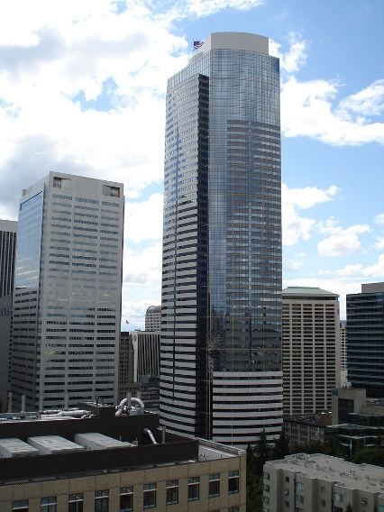
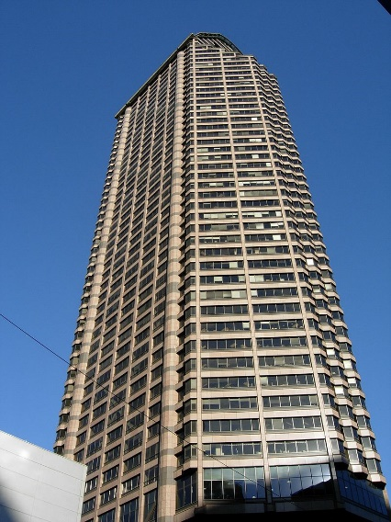
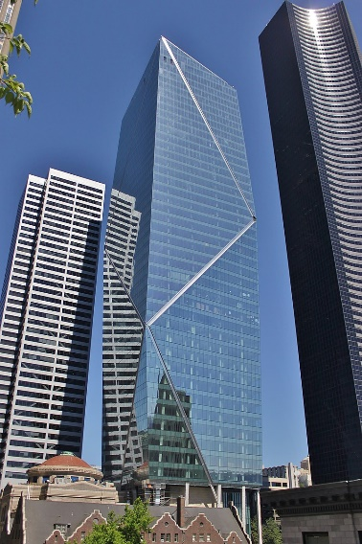
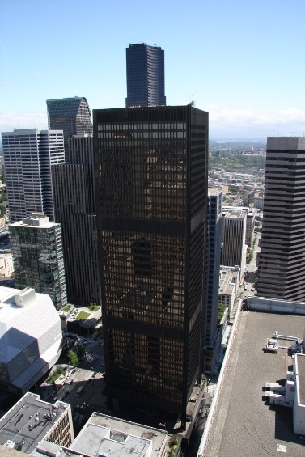

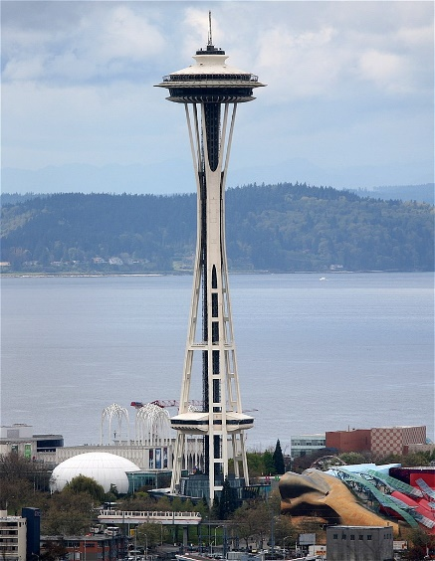
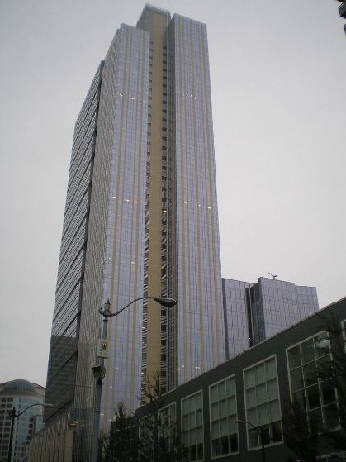
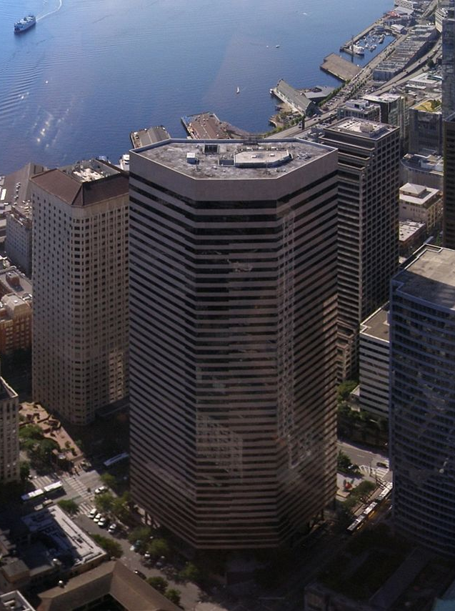
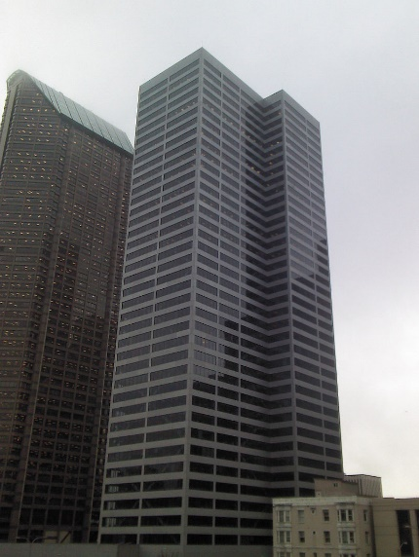
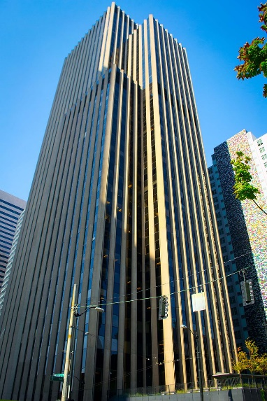
Visiting Seattle from Tallest to Smallest
1) Columbia Center
2) Washington Mutual Tower
3) Two Union Square
4) Seattle Municipal Tower
5) F5 Tower
6) Safeco Plaza
7) US Bank Center
8) Space Needle
9) Russell Investments Center
10) DocuSign Tower
11) 800 Fifth Ave
12) 901 Fifth Ave

Slide 16

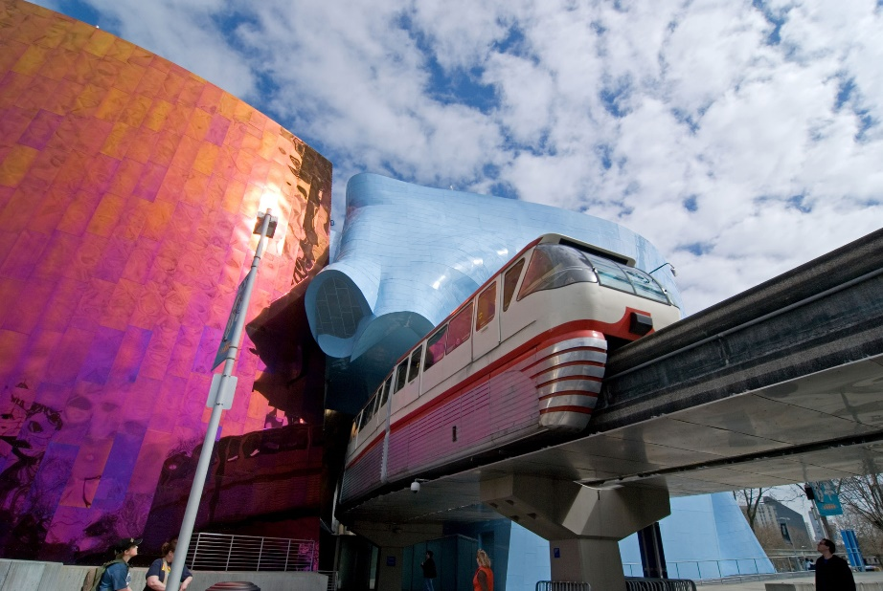

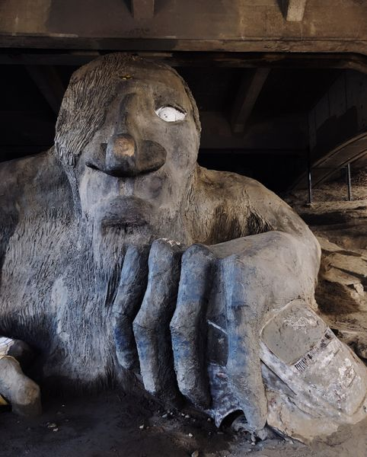

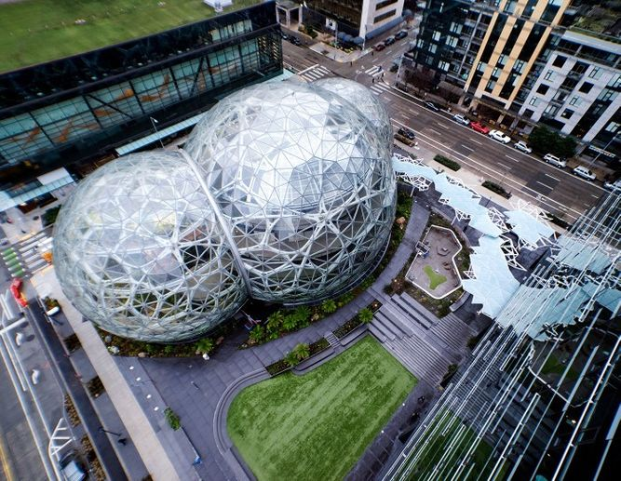
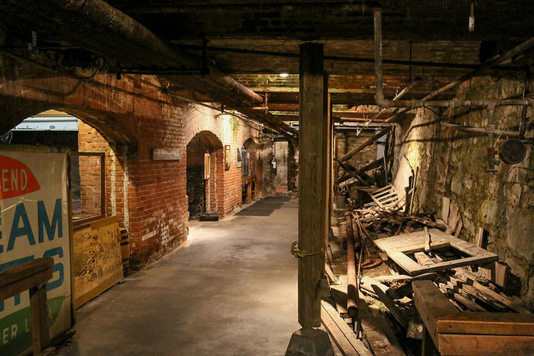
You would miss …
If you wouldn’t visit Seattle by going to the tallest structures, why would we use this approach to understand protein mixtures???

Slide 17
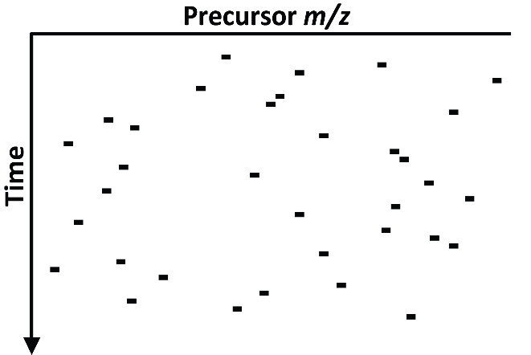
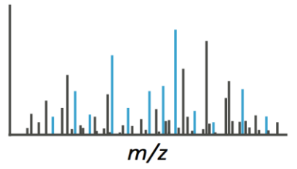
Mass Spectrometry Data Acquisition Strategies Used in Proteomics
Data Dependent Acquisition (DDA)
NLPFSVENK
Database Searching
Peptide Identification

Slide 18
So what do we do?
Build on Other People’s Knowledge

Slide 19

So what do we do?

Slide 20
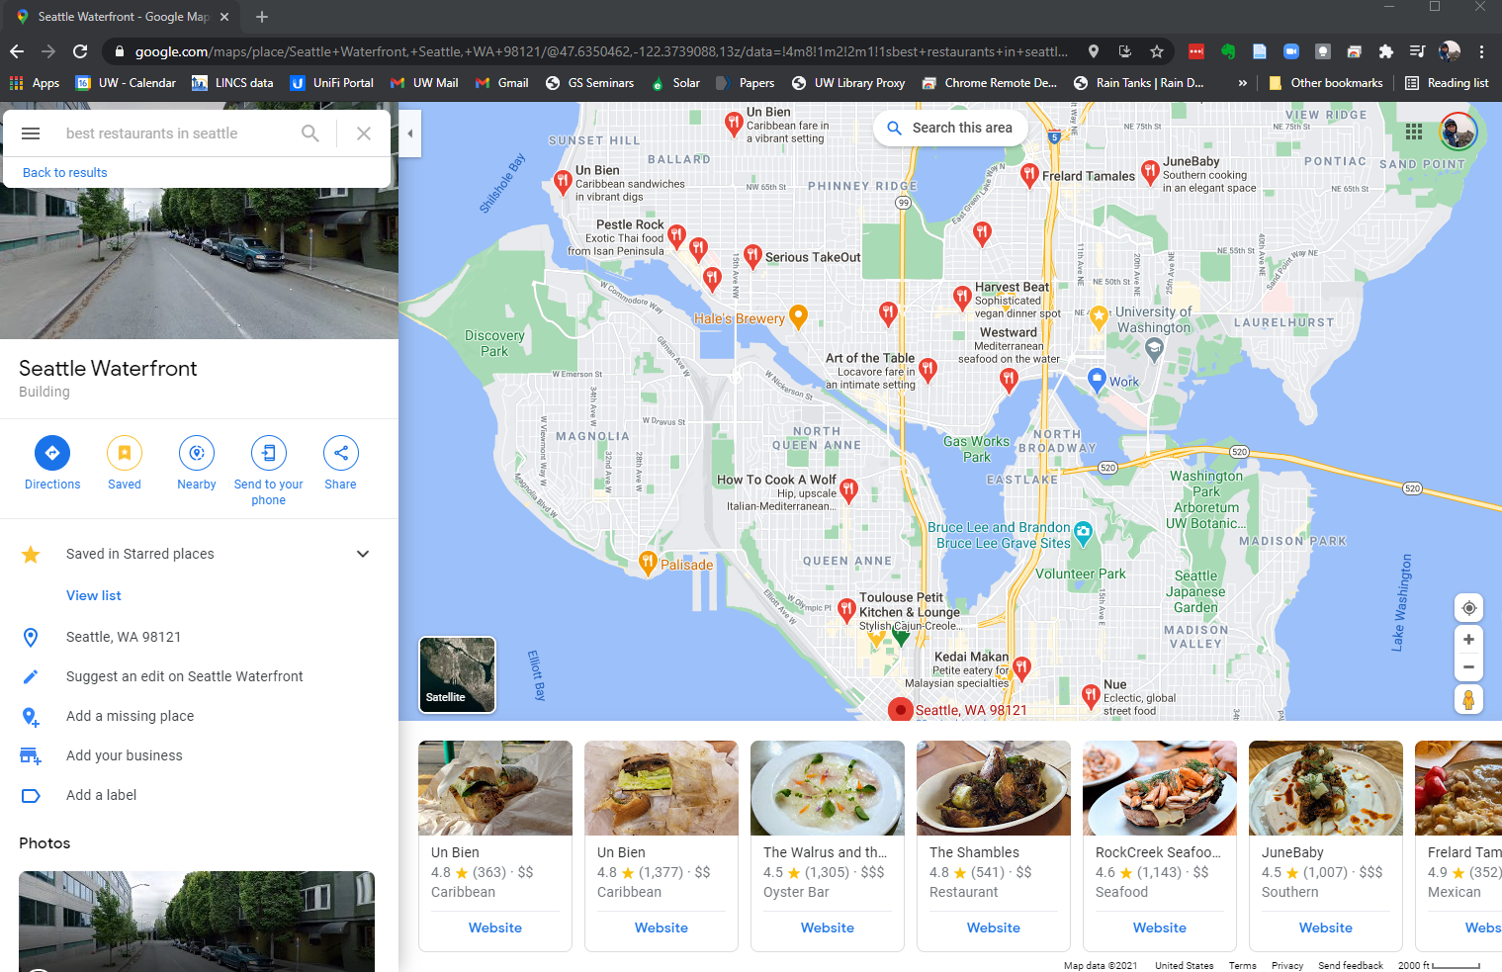
So what do we do?

Slide 21
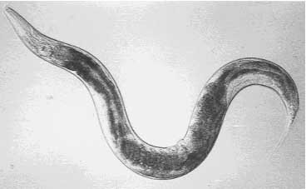
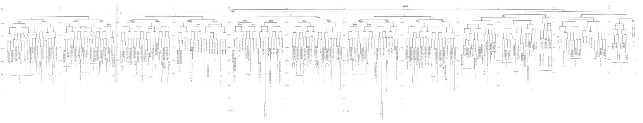
C. elegans as an In Vivo Model System for Proteomics
The only multicellular organism with a genome sequenced to completeness
Complete Lineage for all 959 Somatic Cells

Slide 22
Humans
C. elegans
Insulin Receptor
DAF-2
IRS1-4
IST-1
pi 3-kinase
AGE-1
PDK1
PDK-1
AKT/PKB
AKT-1/AKT-2
FKHR
FKHRL1
AFX
DAF-16

Slide 23
Fractionation to Improve the Coverage of Proteins Involved in Insulin / IGF-1 Signaling
Soluble Proteins
Insoluble Proteins
0 Proteins Identified that are Known to be Involved in the Insulin / IGF-1 Signaling Pathway
Reversed Phase 10 Fractions
(NH₄)₂SO₄ Cuts 8 Fractions
Density Centrifugation 10 Fractions
10 MudPITs
8 MudPITs
10 MudPITs
>6,000,000 MS/MS Spectra, 67,047 Unique Peptide Identifications, and 6,779 Unique Protein Identifications

Slide 24
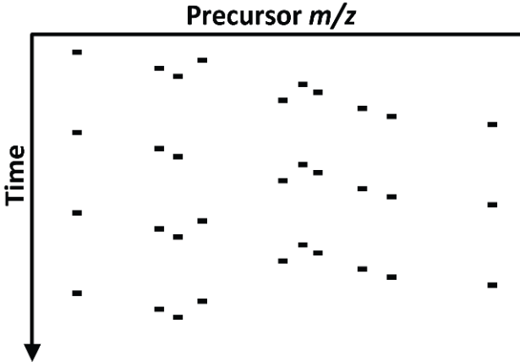
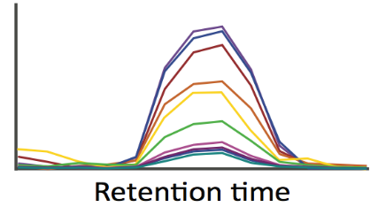
Mass Spectrometry Data Acquisition Strategies Used in Proteomics
Data Dependent Acquisition (DDA)
Parallel Reaction Monitoring (PRM)
Cycle time
NLPFSVENK
NLPFSVENK
Database Searching
Targeted Analysis
Peptide Identification
Peptide Quantification

Slide 25
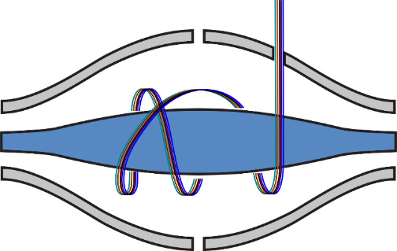
SRM
Targeted Acquisition
Mass Filter
Unit Resolution
Targeted Extraction
Mass Analysis
Full Spectrum
Often Accurate mass
PRM

Slide 26
Q1
CID
Q3
Ion Source
521.7
757.6

Slide 27
Precursor Ion > Product Ion
TGASEAVPSEGK > GK
TGSAEAVPSEGK > EGK
TGSAEAVPSEGK > SEGK
TGSAEAVPSEGK > PSEGK
TGSAEAVPSEGK > VPSEGK
TGSAEAVPSEGK > AVPSEGK
TGSAEAVPSEGK > EAVPSEGK
TGSAEAVPSEGK > AEAVPSEGK
TGSAEAVPSEGK > SAEAVPSEGK
SRM Chromatograms
y2
566.78 > 204.13
y3
566.78 > 333.18
y4
566.78 > 420.21
y5
566.78 > 517.26
y6
566.78 > 616.33
y7
566.78 > 687.37
y8
566.78 > 816.41
y9
566.78 > 903.44
y10
566.78 > 1031.5

Slide 28
IDATTHIGGVQIK DAF-16
QEDVVIEGWLHK AKT-1
Worm Homogenate 25 µg
75 attomole IDATTHIGGVQIK
7.5 femtomole QEDVVIEGWLHK
Synthetic Peptide Standards

Slide 29
Dilution of the Yeast Protein PGI1 in Undepleted Human Plasma
Peptide: ILFDYSK
R = 0.99992

Slide 30
Dilution of the Yeast Protein PGI1 in Undepleted Human Plasma
Peptide: ILFDYSK
R = 0.99992

Slide 31
Dilution of the Yeast Protein PGI1 in Undepleted Human Plasma
Peptide: ILFDYSK
R = 0.99992

Slide 32
12 Attomoles of ILFDYSK on Column in 10 µg of Unfractionated Human Plasma
*

Slide 33
Questions When Developing a Targeted Assay
What peptides are 1) detectable, 2) chromatograph well, 3) are unique to, and 4) are stable and robust over time.
What transitions provide a sensitive and unique measure of that peptide

Slide 34
A Case Study in Developing a Targeted “Wellness Assay” from Dried Blood Spots by Empirical Refinement

Slide 35
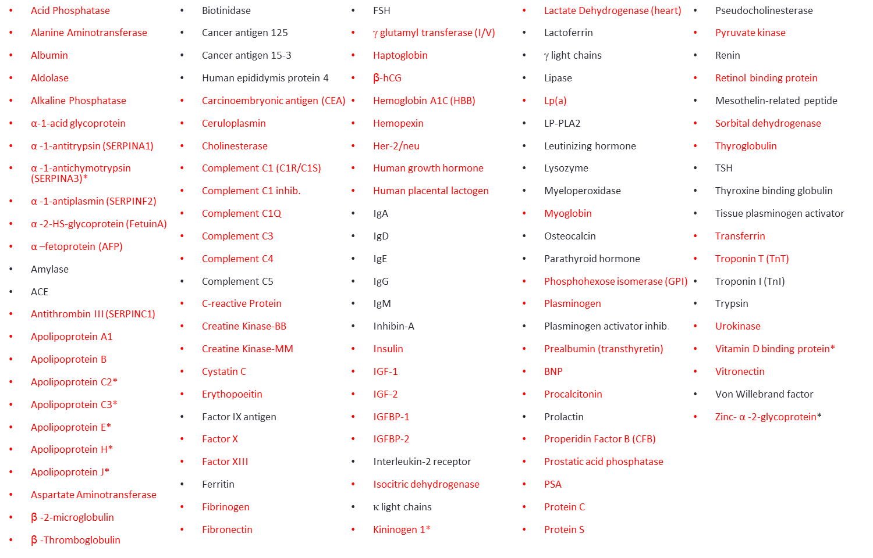
Selection of Protein Targets for DBS Wellness Assay
Acid Phosphatase
Alanine Aminotransferase
Albumin
Aldolase
Alkaline Phosphatase
α-1-acid glycoprotein
α -1-antitrypsin (SERPINA1)
α -1-antichymotrypsin (SERPINA3)*
α -1-antiplasmin (SERPINF2)
α -2-HS-glycoprotein (FetuinA)
α –fetoprotein (AFP)
Amylase
ACE
Antithrombin III (SERPINC1)
Apolipoprotein A1
Apolipoprotein B
Apolipoprotein C2*
Apolipoprotein C3*
Apolipoprotein E*
Apolipoprotein H*
Apolipoprotein J*
Aspartate Aminotransferase
β -2-microglobulin
β -Thromboglobulin
Biotinidase
Cancer antigen 125
Cancer antigen 15-3
Human epididymis protein 4
Carcinoembryonic antigen (CEA)
Ceruloplasmin
Cholinesterase
Complement C1 (C1R/C1S)
Complement C1 inhib.
Complement C1Q
Complement C3
Complement C4
Complement C5
C-reactive Protein
Creatine Kinase-BB
Creatine Kinase-MM
Cystatin C
Erythopoeitin
Factor IX antigen
Factor X
Factor XIII
Ferritin
Fibrinogen
Fibronectin
FSH
γ glutamyl transferase (I/V)
Haptoglobin
β-hCG
Hemoglobin A1C (HBB)
Hemopexin
Her-2/neu
Human growth hormone
Human placental lactogen
IgA
IgD
IgE
IgG
IgM
Inhibin-A
Insulin
IGF-1
IGF-2
IGFBP-1
IGFBP-2
Interleukin-2 receptor
Isocitric dehydrogenase
$κ$ light chains
Kininogen 1*
Lactate Dehydrogenase (heart)
Lactoferrin
γ light chains
Lipase
Lp(a)
LP-PLA2
Leutinizing hormone
Lysozyme
Myeloperoxidase
Myoglobin
Osteocalcin
Parathyroid hormone
Phosphohexose isomerase (GPI)
Plasminogen
Plasminogen activator inhib.
Prealbumin (transthyretin)
BNP
Procalcitonin
Prolactin
Properidin Factor B (CFB)
Prostatic acid phosphatase
PSA
Protein C
Protein S
Pseudocholinesterase
Pyruvate kinase
Renin
Retinol binding protein
Mesothelin-related peptide
Sorbital dehydrogenase
Thyroglobulin
TSH
Thyroxine binding globulin
Tissue plasminogen activator
Transferrin
Troponin T (TnT)
Troponin I (TnI)
Trypsin
Urokinase
Vitamin D binding protein*
Vitronectin
Von Willebrand factor
Zinc- α -2-glycoprotein*
Adapted from: Tables 1& 2 - N. Leigh Anderson. Clin. Chem. (2010), 56, 177-185.

Slide 36
Spectrum Counts vs. SRM Signal Intensity: Apolipoprotein B100
Prakash, A. et al. J Proteome Res. 2009 8(6): 2733–2739.
Notes:
Although these approaches are better than selecting proteotypic peptides at random, our results suggest that current predictor algorithms and spectral counting approaches provide imperfect ranking and identification of optimal proteotypic peptides, potentially limiting the utility of large-scale peptide-synthesis efforts that rely on such approaches as a first-round filter.

Slide 37


Our Refinement Workflow
Number of peptides/ protein
Process
Skyline
Matrix
Method Development
Recombinant protein production
Protein Extraction
~30
Monitor all tryptic peptides
Peptide: 7-23 aa, +2
Product: from y3 to yn − 1, +1
Digestion
~20
Selection of transitions
and iRT
Filter and selection
4 transitions/peptide
m/z fragment > m/z precursor
10 µg
RT standards;
GST heavy
CFB heavy
~10
Peptide stability analysis
Filter and Selection
Build library in Panorama
Control
n=8
OSCC
n=22
~5
Validation of transitions in the matrix
Recombinant Library (Dotp) and Retention time prediction
Triple quadrupole
SRM analysis
3
Optimization of transitions
Filter and Selection
3 peptides per protein
Data analysis

Slide 38
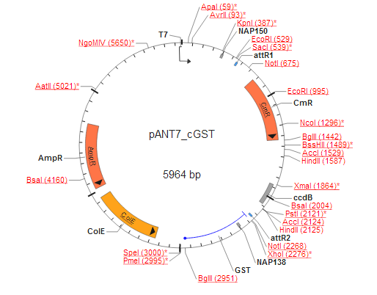
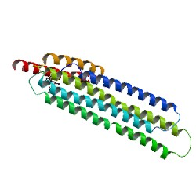
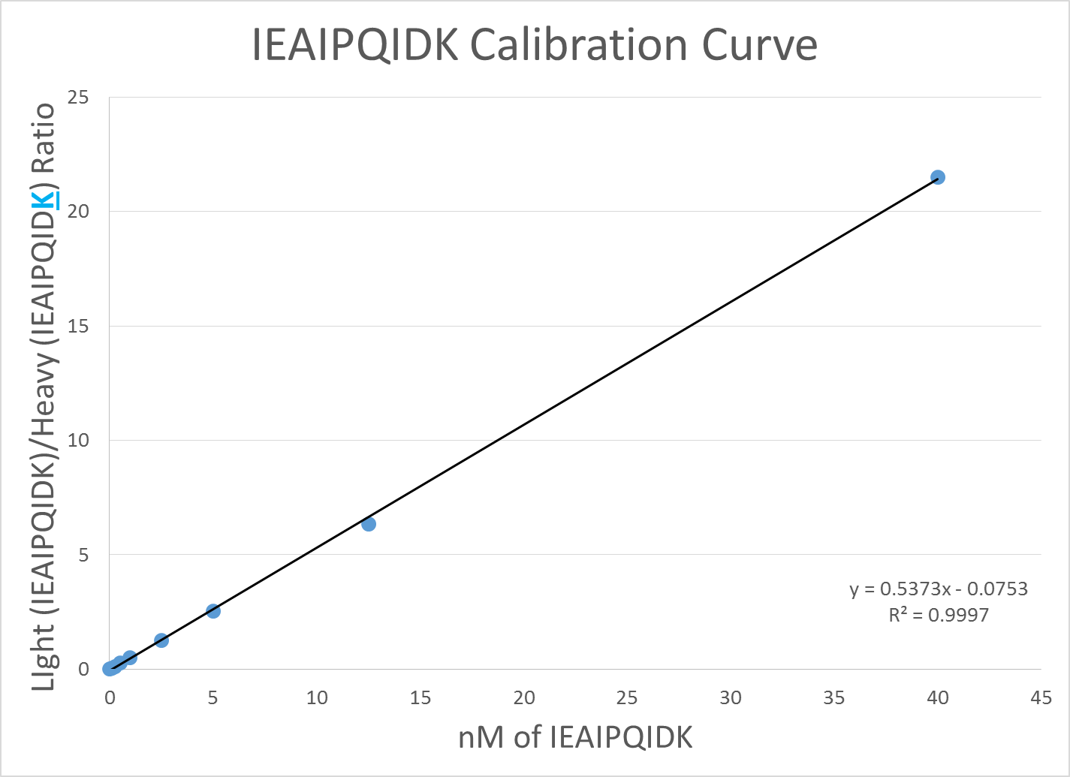
Workup of Recombinant/Native Protein Standard
Expand, Purify, & Sequence cDNA clone
In Vitro Transcription and Translation
Enrichment via Glutathione-Sepharose Resin
http://dnasu.org
GST
Gene Product of Interest
IEAIPQIDK
+
IEAIPQIDK
~25-500 femtomoles/25 uL IVT
< $20.00/Protein
Notes:
The 1-Step Human IVT System uses HeLa cell lysates to perform cell-free protein expression. Using a human-based system yields proteins that mirror natural proteins with respect to post-translational modifications and results in proteins that exhibit natural protein function and structure.

Slide 39
Our Refinement Workflow
Number of peptides/ protein
Process
Skyline
Matrix
Method Development
Recombinant protein production
Protein Extraction
~30
Monitor all tryptic peptides
Peptide: 7-23 aa, +2
Product: from y3 to yn − 1, +1
Digestion
~20
Selection of transitions
and iRT
Filter and selection
4 transitions/peptide
m/z fragment > m/z precursor
10 µg
RT standards;
GST heavy
CFB heavy
~10
Peptide stability analysis
Filter and Selection
Build library in Panorama
Control
n=8
OSCC
n=22
~5
Validation of transitions in the matrix
Recombinant Library (Dotp) and Retention time prediction
Triple quadrupole
SRM analysis
3
Optimization of transitions
Filter and Selection
3 peptides per protein
Data analysis

Slide 40
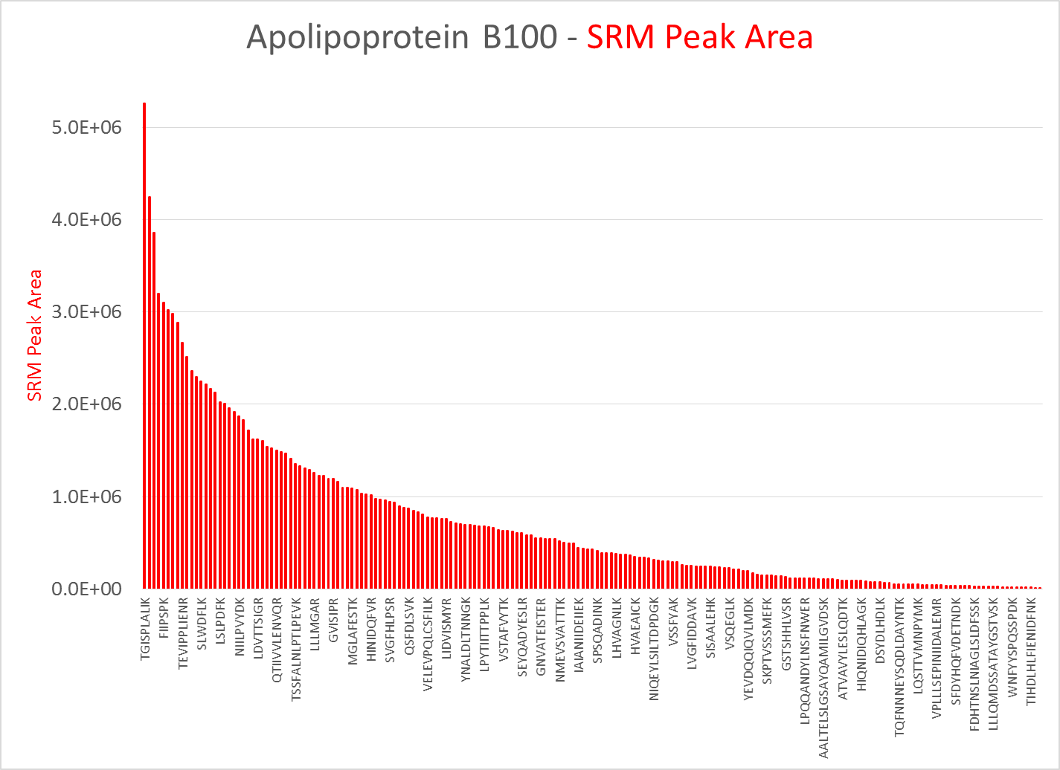
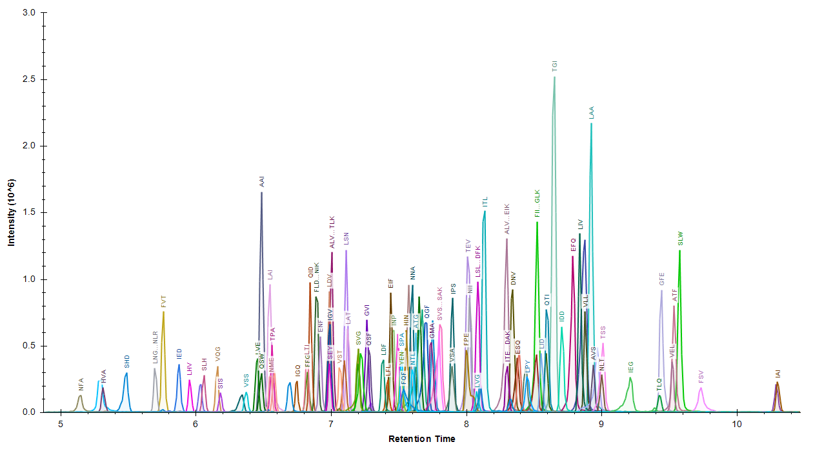
nanoLC MS/MS: SRM Signal Intensity Rank
Notes:
Feel for peak shape

Slide 41
Our Refinement Workflow
Number of peptides/ protein
Process
Skyline
Matrix
Method Development
Recombinant protein production
Protein Extraction
~30
Monitor all tryptic peptides
Peptide: 7-23 aa, +2
Product: from y3 to yn − 1, +1
Digestion
~20
Selection of transitions
and iRT
Filter and selection
4 transitions/peptide
m/z fragment > m/z precursor
10 µg
RT standards;
GST heavy
CFB heavy
~10
Peptide stability analysis
Filter and Selection
Build library in Panorama
Control
n=8
OSCC
n=22
~5
Validation of transitions in the matrix
Recombinant Library (Dotp) and Retention time prediction
Triple quadrupole
SRM analysis
3
Optimization of transitions
Filter and Selection
3 peptides per protein
Data analysis

Slide 42
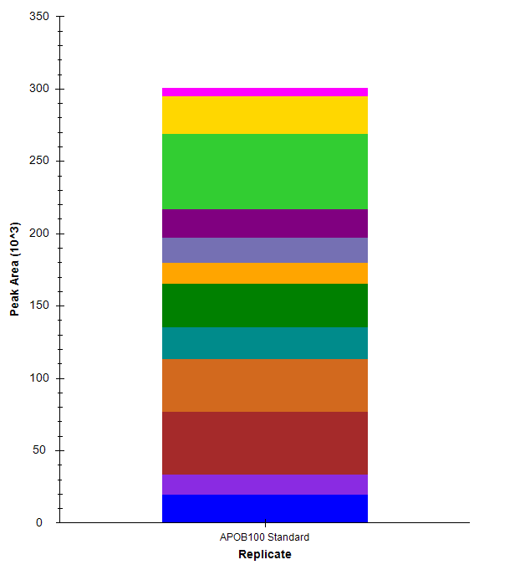
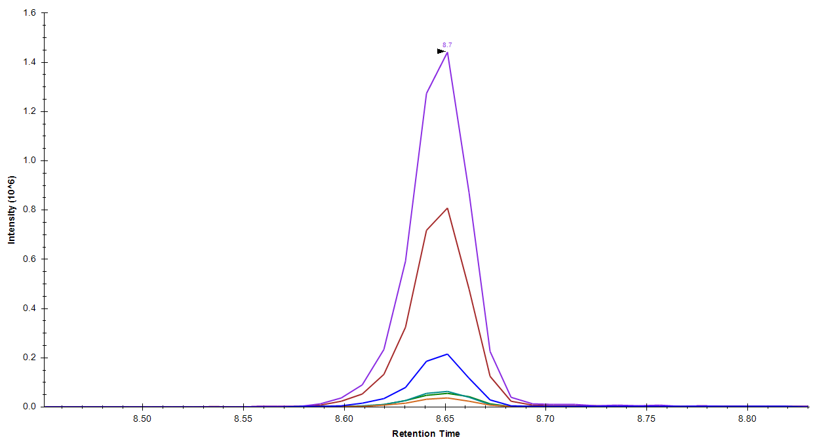
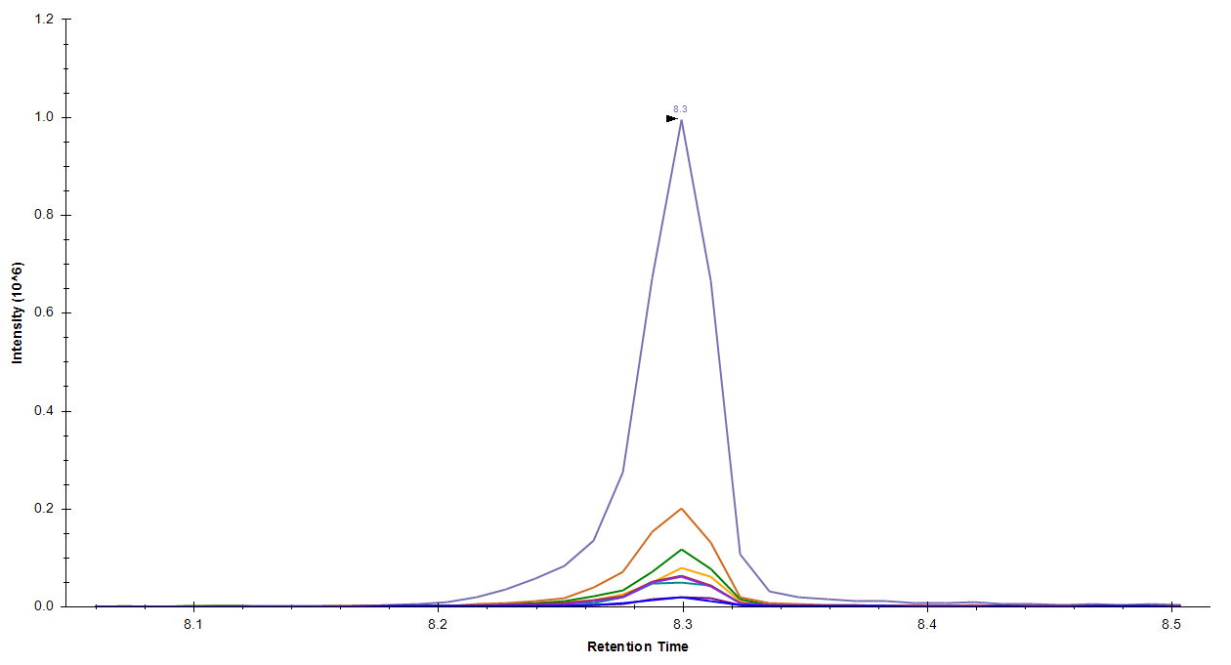
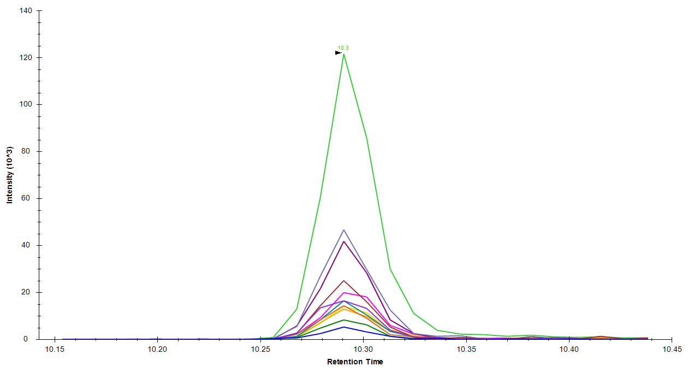
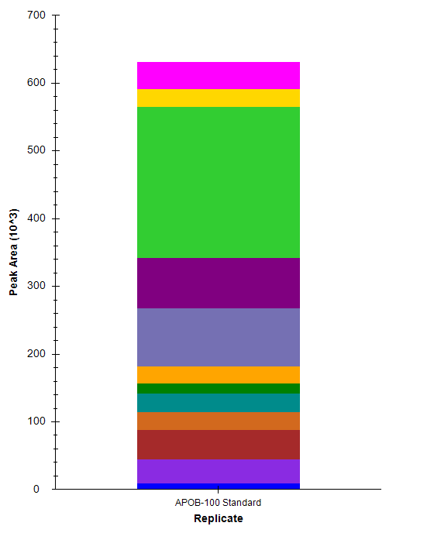
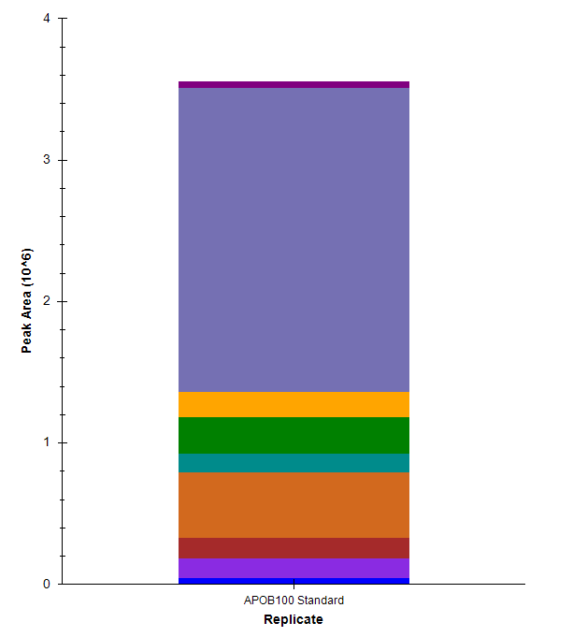
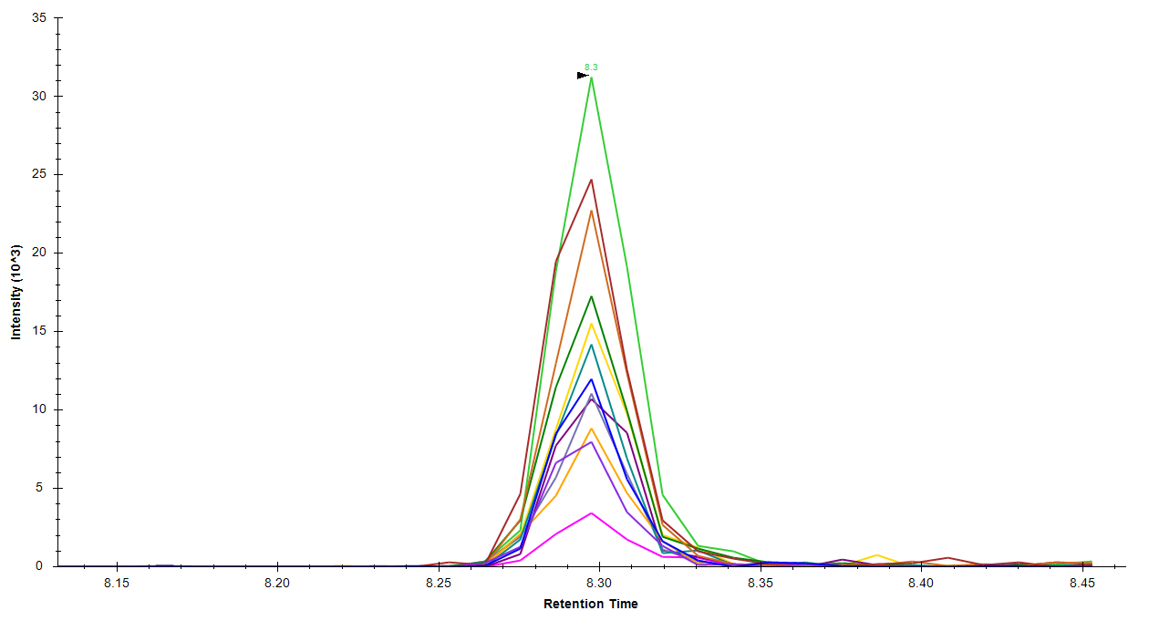
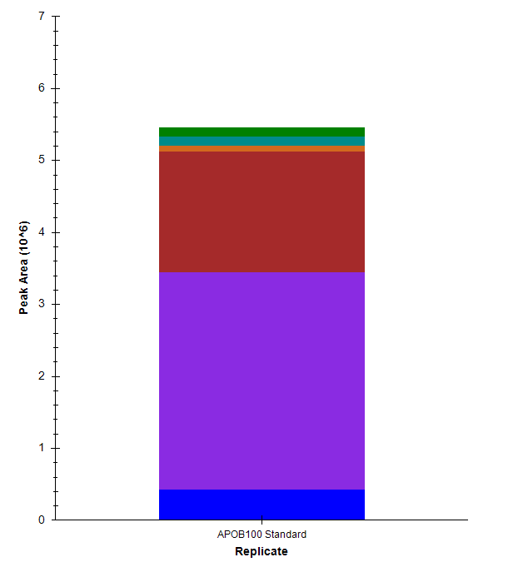
nanoLC MS/MS: Fragmentation Fingerprint
R.YEDGTLSLTSTSDLQSGIIK.N [1536, 1555]
K.TTLTAFGFASADLIEIGLEGK.G [674, 694]
K.ALVEQGFTVPEIK.T [2578, 2590]
R.TGISPLALIK.G [219, 228]

Slide 43
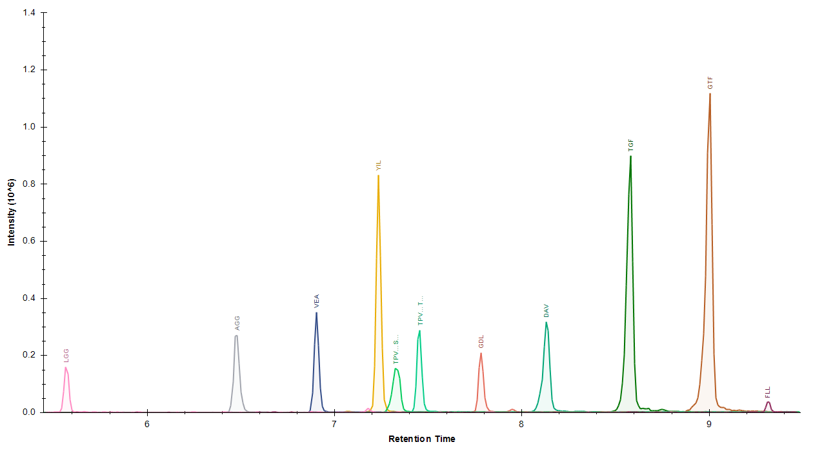
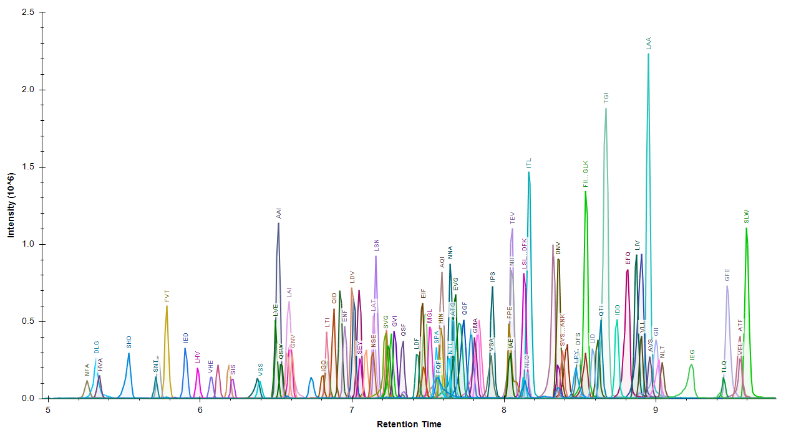
iRT Calibration

Slide 44
Our Refinement Workflow
Number of peptides/ protein
Process
Skyline
Matrix
Method Development
Recombinant protein production
Protein Extraction
~30
Monitor all tryptic peptides
Peptide: 7-23 aa, +2
Product: from y3 to yn − 1, +1
Digestion
~20
Selection of transitions
Filter and selection
4 transitions/peptide
m/z fragment > m/z precursor
10 µg
RT standards;
GST heavy
CFB heavy
~10
Peptide stability analysis
Filter and Selection
Build library in Panorama
Control
n=8
OSCC
n=22
~5
Validation of transitions in the matrix
Recombinant Library (Dotp) and Retention time prediction
Triple quadrupole
SRM analysis
3
Optimization of transitions
Filter and Selection
3 peptides per protein
Data analysis

Slide 45
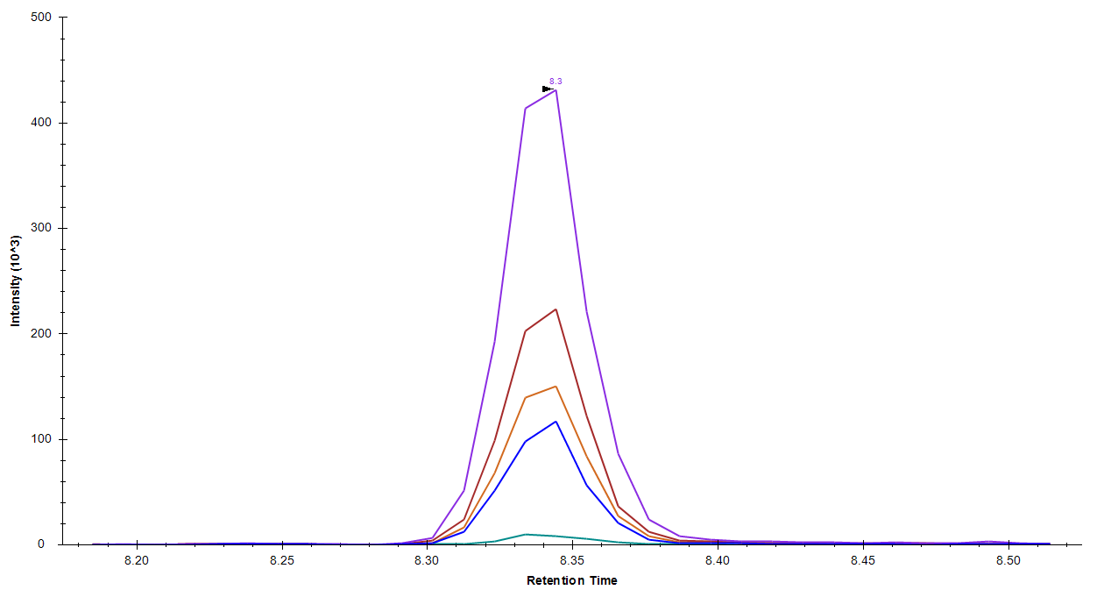



nanoLC MS/MS: Peptide Stability Analysis
K.DNVFDGLVR.V [4168, 4176]
K.TTLTAFGFASADLIEIGLEGK.G [674, 694]
R.TGISPLALIK.G [219, 228]
Standard
Standard
72hrs in A/S
Standard
Standard
72hrs in A/S
Standard
Standard
72hrs in A/S

Slide 46
Our Refinement Workflow
Number of peptides/ protein
Process
Skyline
Matrix
Method Development
Recombinant protein production
Protein Extraction
~30
Monitor all tryptic peptides
Peptide: 7-23 aa, +2
Product: from y3 to yn − 1, +1
Digestion
~20
Selection of transitions
Filter and selection
4 transitions/peptide
m/z fragment > m/z precursor
10 µg
RT standards;
GST heavy
CFB heavy
~10
Peptide stability analysis
Filter and Selection
Build library in Panorama
Control
n=8
OSCC
n=22
~5
Validation of transitions in the matrix
Recombinant Library (Dotp) and Retention time prediction
Triple quadrupole
SRM analysis
3
Optimization of transitions
Filter and Selection
3 peptides per protein
Data analysis

Slide 47










Validation of Peptides/Transitions in Matrix
K.SPAFTDLHLR.Y [3979, 3988]
R.EFQVPTFTIPK.L [1333, 1343]

Slide 48



Digestion Time Course
K.ALVEQGFTVPEIK.T [2578, 2590]

Slide 49

255 Peptides Measured in a Single LC-MS/MS Run (63 Proteins)

Slide 50

255 Peptides Measured in a Single LC-MS/MS Run (63 Proteins)

Slide 51
Quantitative Analysis 101
What is does it mean to be quantitative?
Notes:
Poll 3 … what does it mean to be quantitative

Slide 52


Peak area measurements should scale with the amount of peptide in the sample
known quantity

Slide 53
Quantitative Analysis 101
ULOQ
Linear Dynamic Range
Measured Intensity (Area)
LOD
LLOQ
Amount (moles)
LOD: Limit of Detection
LLOQ: Lower Limit of Quantitation
ULOQ: Upper Limit of Quantitation

Slide 54
Quantitative Analysis 101: Using an Internal Std
ULOQ
Linear Dynamic Range
Intensity Ratio (Area Ratio)
LOD
LLOQ
Amount (moles)
LOD: Limit of Detection
LLOQ: Lower Limit of Quantitation
ULOQ: Upper Limit of Quantitation

Slide 55
Quantitative Analysis 101
What is does it mean to be quantitative?
What does signal calibration mean?
Notes:
Poll 4
What does signal calibration mean

Slide 56

Measurements on different platforms are not measured on the same scale

Slide 57
Between Batch/Platform/Lab Signal Calibration
Purpose of signal calibration
Placing signal on the same scale
Often the scale is arbitrary
Kilogram = mass of a liter of water at freezing point
Meter = 1/10,000,000 the distance from the equator to the north pole
Pee dee belomnite (PDB) = reference for 13C, fossil found in Peedee Formation in South Carolina
Standard mean ocean water (SMOW) = reference for 18O, arbitrary mix of distilled water from different regions of the world.

Slide 58
Questions:
Can a method be quantitative if you don’t know the range over which the signal reflects the quantity?

Slide 59
What does it mean if these are the two points?
ULOQ
Linear Dynamic Range
Measured Intensity (Area)
LOD
LLOQ
Amount (moles)
LOD: Limit of Detection
LLOQ: Lower Limit of Quantitation
ULOQ: Upper Limit of Quantitation

Slide 60
Questions:
Can a method be quantitative if you don’t know the range over which the signal reflects the quantity?
Design an approach to confirm linearity and LLOQ for peptides in a complex matrix?
Assume you have < 50 peptides in your assay.
Assume you have >1000 peptides in your assay?

Slide 61


Matched Matrix Dilution Curves
Building on: Grant and Hoofnagle, Clin Chem 2014
Pino et al, JPR 2020

Slide 62

Not all Peptides are Equal Quantitative Proxies for a Protein
Pino et al, JPR 2020
Notes:
plasma membrane ATPase (PMA1

Slide 63
Two other ways we can think of
Take two samples with extremes in the signal measured from a discovery experiment
Mix samples in different ratios and demonstrate that there is a linear response between the extremes
Method of standard addition

Slide 64
A key reminder: We measure peptides and not proteins.
Plubell et al, BioRxiv 2021

Slide 65

Proteoforms complicate protein level measurements
Plubell et al, BioRxiv 2021
Notes:
Take for example some theoretical protein as indicated on the left – by bottom up proteomics we can possibly detect 4 tryptic peptides that map to our database sequence.

Slide 66
Proteoforms complicate protein level measurements
Plubell et al, BioRxiv 2021
Notes:
Take for example some theoretical protein as indicated on the left – by bottom up proteomics we can possibly detect 4 tryptic peptides that map to our database sequence.

Slide 67

Proteoforms complicate protein level measurements
Plubell et al, BioRxiv 2021
Notes:
Take for example some theoretical protein as indicated on the left – by bottom up proteomics we can possibly detect 4 tryptic peptides that map to our database sequence.

Slide 68

Peptide level quant can reflect protein level differences
Example: GAPDH (glyceraldehyde-3-phosphate dehydrogenase) in cerebrospinal fluid
Protein-level quantification
Notes:
So here we have a protein from this cerebrospinal fluid, GAPDH, and for the protein quantification we are assuming that all the peptides that map to the protein coding sequence and used for generating that value will be increased in the Parkinson’s compared to the other two groups,

Slide 69

Peptide level quant can reflect protein level differences
Example: GAPDH (glyceraldehyde-3-phosphate dehydrogenase) in cerebrospinal fluid
Protein-level quantification
Peptide-level quantification
Notes:
In this case all our peptides have the same trend across the experimental groups, and based on this data it is probably fine to aggregate these peptides to a single value.

Slide 70


Summing to protein-level can mask interesting differences
Example: SCG2 (secretogranin-2) in cerebrospinal fluid
Protein-level quantification
Peptide-level quantification
Notes:
However, we have cases in which the protein quant doesn’t seem to be changing across experimental groups, but on the individual peptide level we have some peptides that do appear to change, sometimes in opposite directions from one another.

Slide 71
Ways to improve the quantitative precision

Slide 72



Metabolically Labeling as an Internal Standard
¹⁵N Enriched Media
¹⁵N Internal Standard
Protein Synthesis
Sample
Cell Lysis
Reduction and Alkylation
Digestion
µLC/µLC/MS/MS
Sample & Int Std Combined

Slide 73
Sample
Internal Std
Sample
Internal Std
Normal Media
¹⁵N Enriched Media
Normal Media
¹⁵N Enriched Media
Cell Lysis
Mix
Derivatization
Cell Lysis
Mix
Proteolytic Digestion
Proteolytic Digestion
µLC-MS/MS
µLC-MS/MS
Identify Peptide
Measure Ratio A
Identify Peptide
Measure Ratio B

Slide 74
Sample
Internal Std
Sample
Internal Std
Normal Media
¹⁵N Enriched Media
Normal Media
¹⁵N Enriched Media
Cell Lysis
Mix
Derivatization
Cell Lysis
Proteolytic Digestion
Proteolytic Digestion
Mix
µLC-MS/MS
µLC-MS/MS
Identify Peptide
Measure Ratio A
Identify Peptide
Measure Ratio B

Slide 75

There are lots of different ways to incorporate an internal standard

